Slide 1
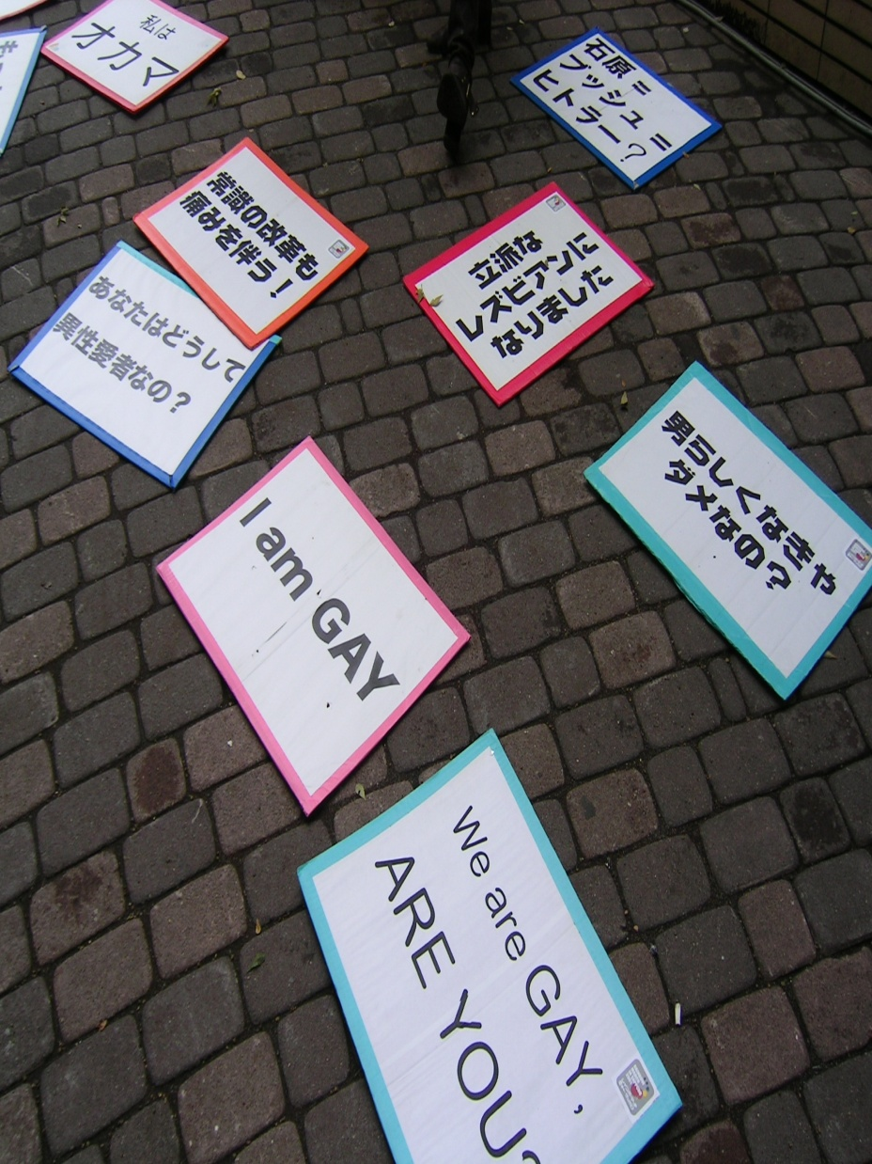
LGBTQ in Japan
A Discussion

Slide 2
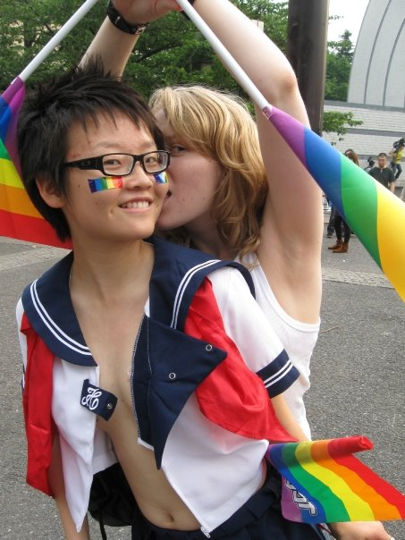
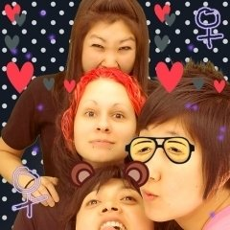
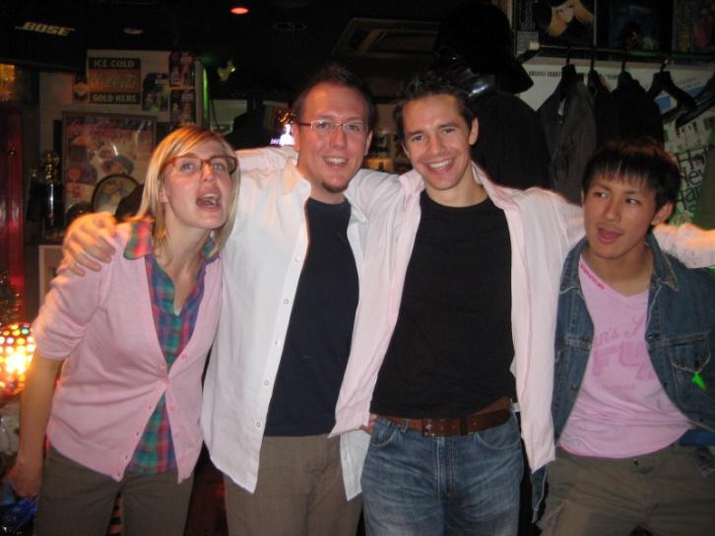
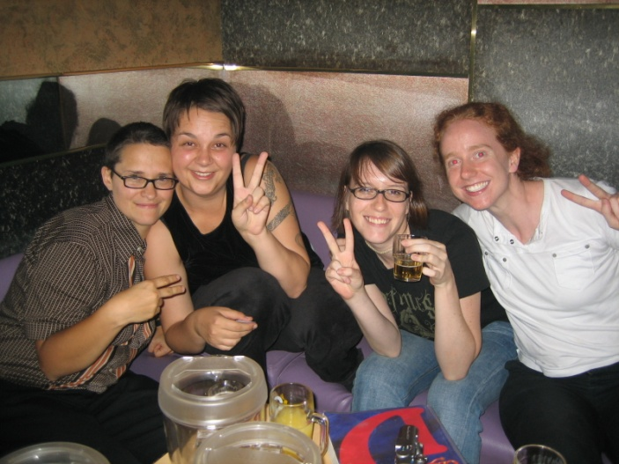
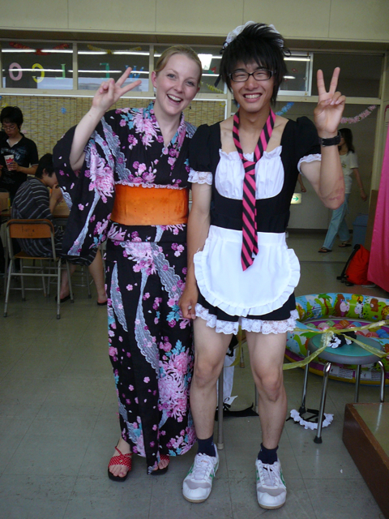
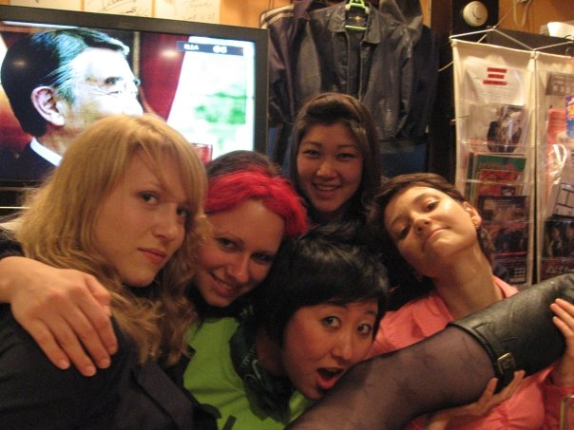

Who are we?

Slide 3
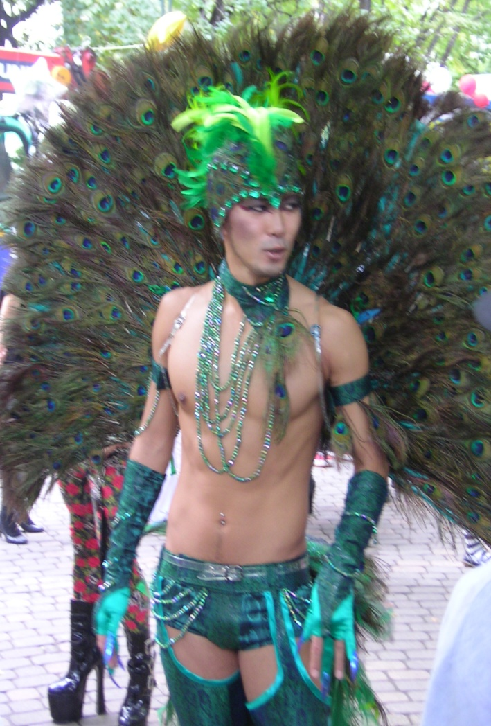
Japanese views on homosexuality
A phase?
    At least until you find the right girl/guy.
Foreigners are weird…
    There are no gay people in Japan, right?
Acceptance?
    But still try to set you up with their friend’s daughter/son.

Slide 4
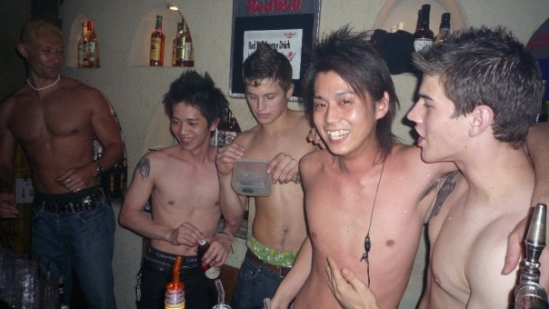
Japanese views on homosexuality (2)
Discrimination?
Safe-sex?

Slide 5

HIV & AIDS
Japan has one of the fastest growing rates of infection in Asia. Especially among gay men.
Free testing centres are around, but may not be able to provide pre/post test counselling in English... Or even Japanese.
See the handout for more info.

Slide 6
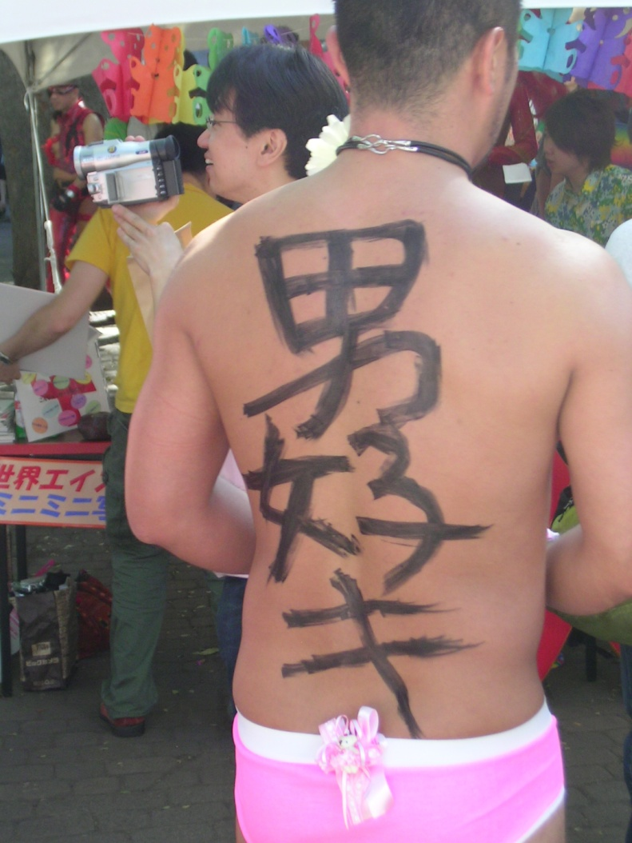
at work
Should you come out at work?
OR
Or somewhere in between?
How do things work in Japanese society with regards to gays in the workplace?

Slide 7

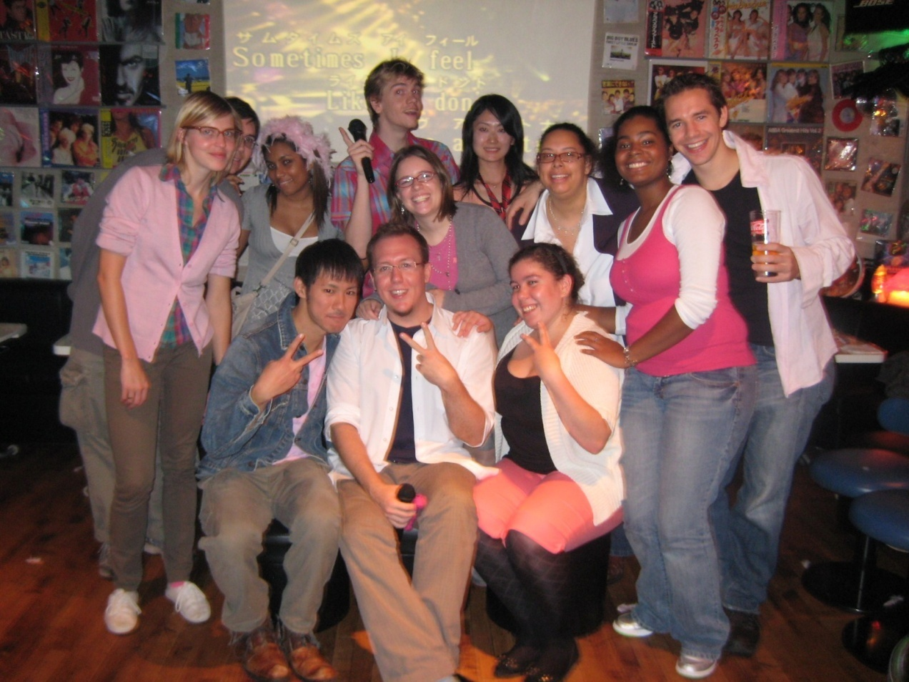


Rural Japan
How do you go about meeting people in rural Japan? Do you meet people?

Slide 8
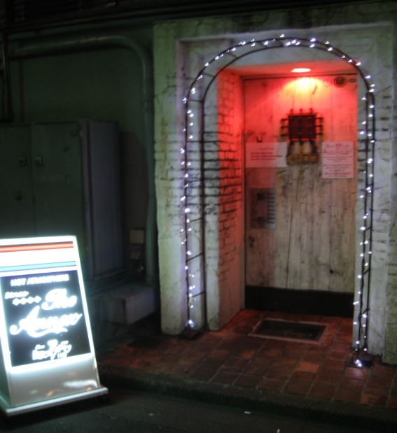
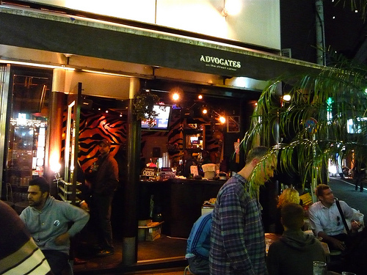
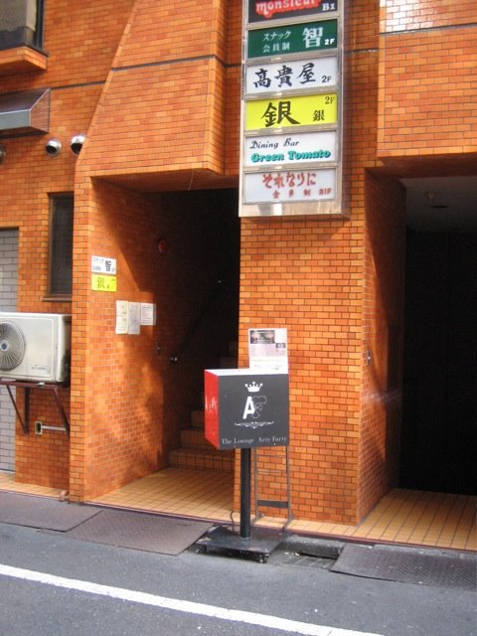
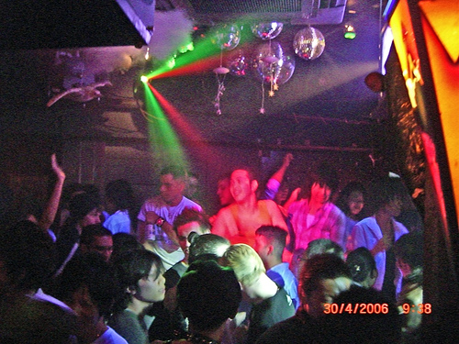
What about this
2-chome place?

Slide 9
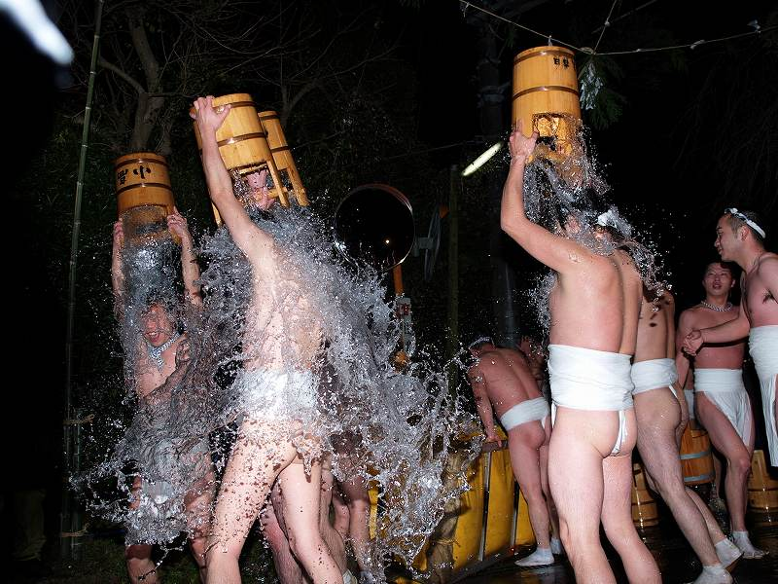
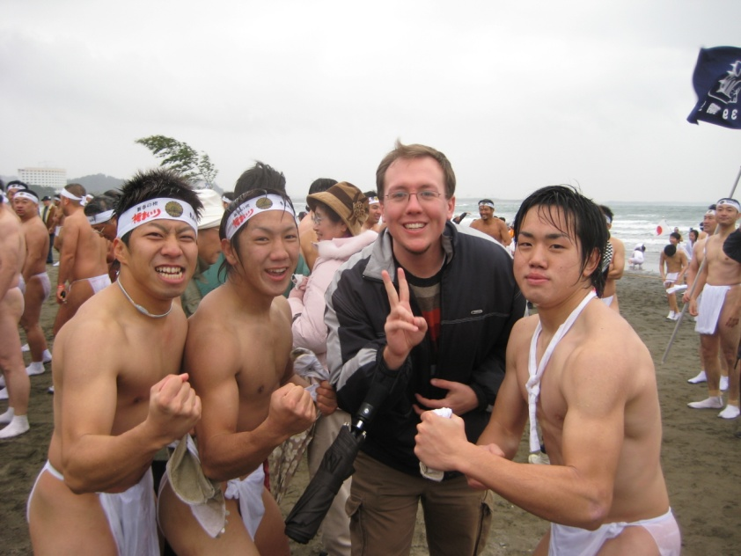
Events and cool things to do!

Slide 10
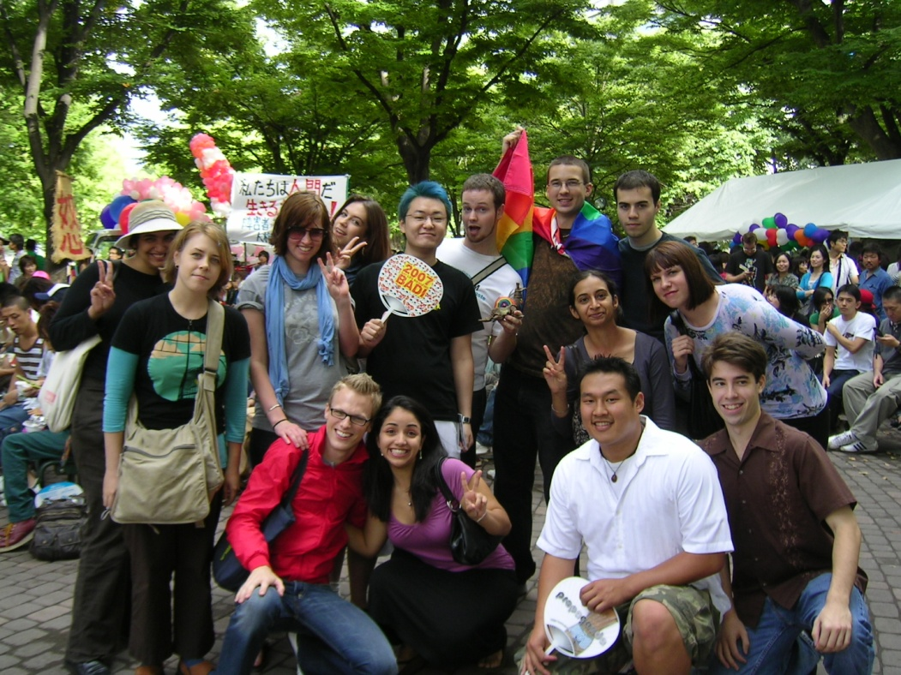
Your turn
It’s question time!

